Slide 1
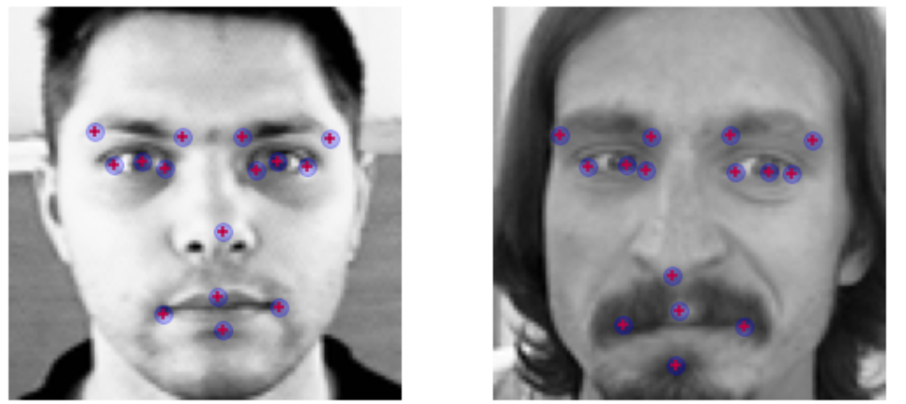
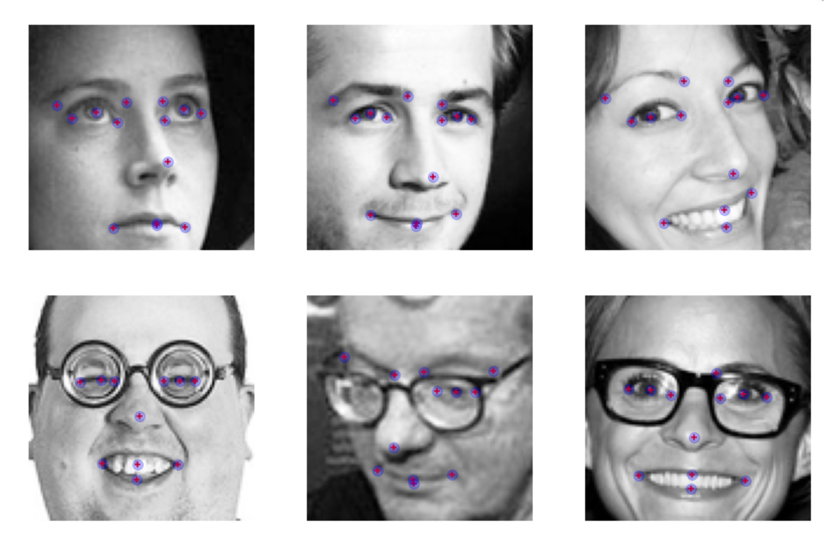
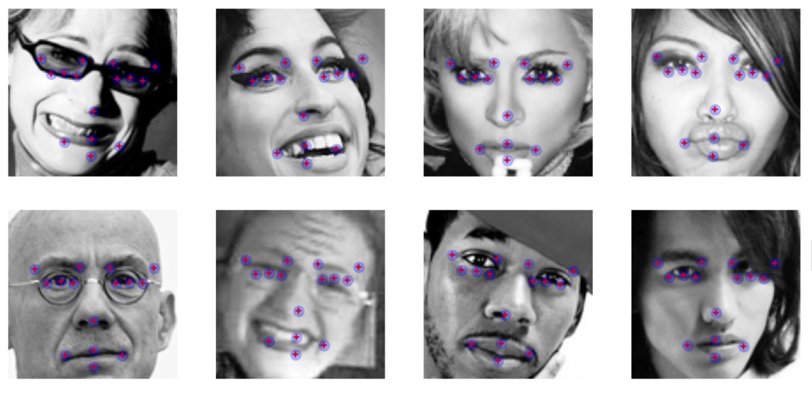
FACIAL KEYPOINTS DETECTION
Michael Bollig and Derek Topper
Berkeley Data Science W207 Final Project

Slide 2
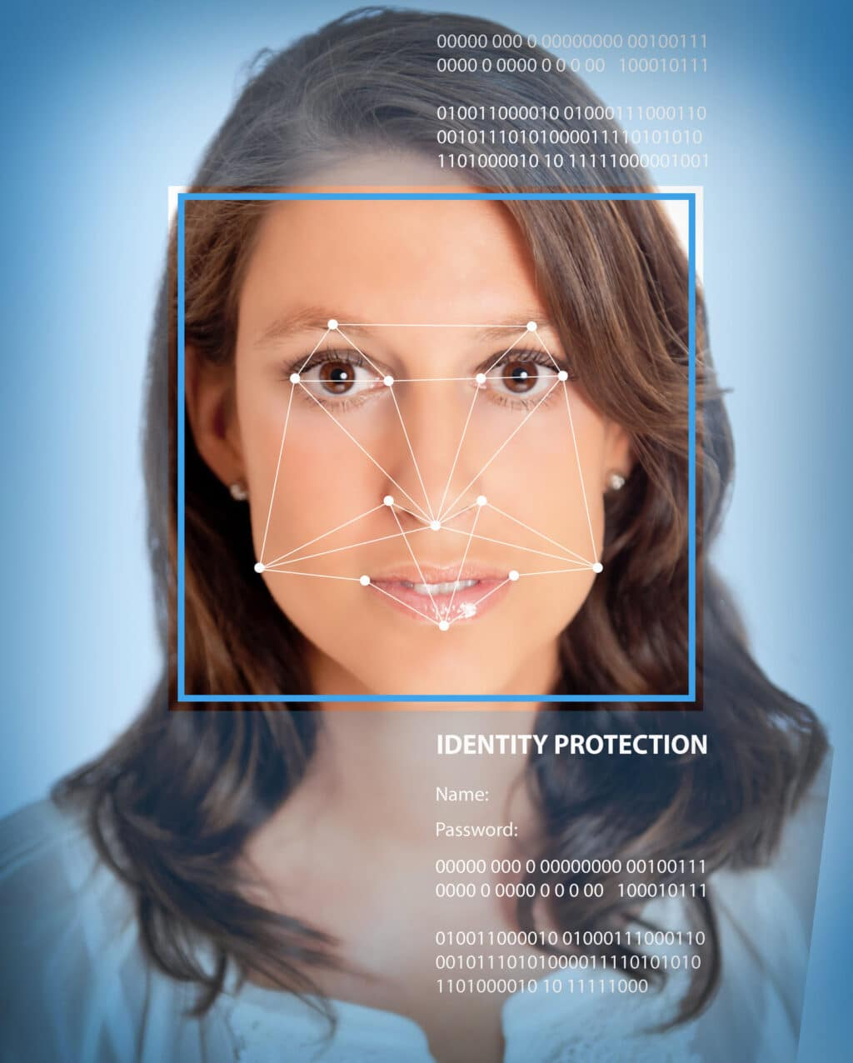
BASIS
Facial recognition is rapidly becoming a key topic in modern life.
Apple uses facial recognition to allow users to unlock their devices.
Snapchat uses facial recognition to put funny face filters overlaid on user images
Academics use facial recognition to research emotions
With so many novel uses for this technology, it is a key reason to understand how to use it.

Slide 3

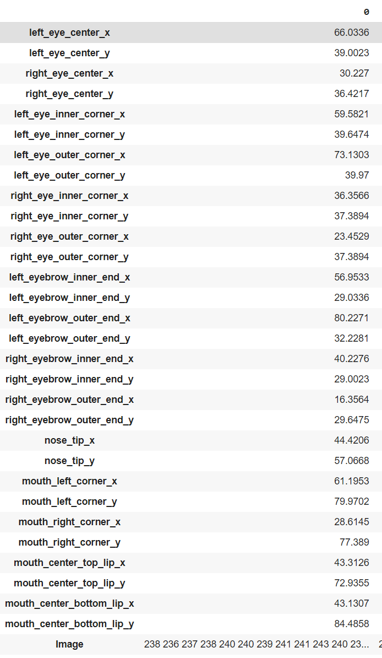
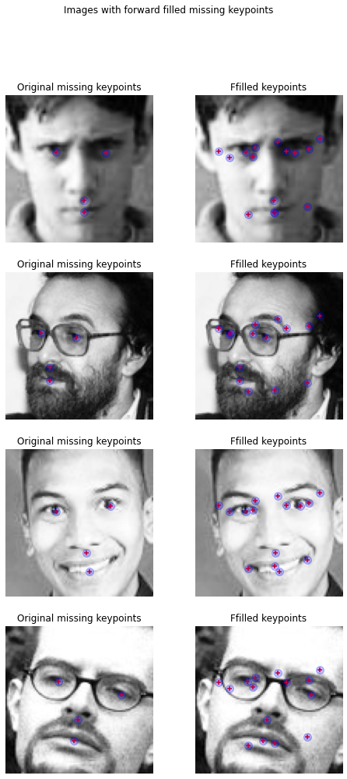
KEYPOINTS
Facial Keypoints are the areas of the nose, eyes, and mouth, that can be classified by a series of points, with coordinates (x, y), for that face.
Every image of a human face has facial keypoints.
There are 15 different keypoints that we'll be identifying in this project.
Left Eye (Center, Inner Corner, Outer Corner)
Right Eye (Center, Inner Corner, Outer Corner)
Left Eyebrow (Inner Corner, Outer Corner)
Right Eyebrow (Inner Corner, Outer Corner)
Nose (Tip)
Mouth (Left Corner, Right Corner, Top Lip, Bottom Lip)
These are among the most important things that our system will look at when identifying people from images.

Slide 4
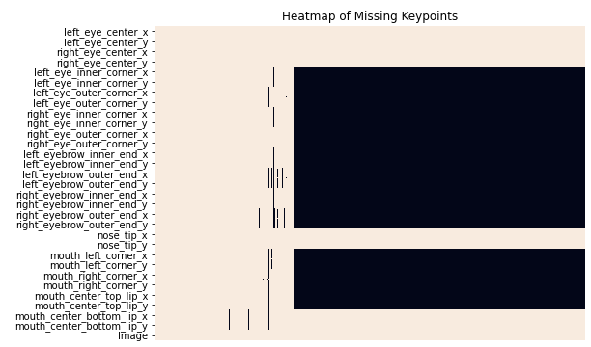
DATA
Using 7049 images from Kaggle’s Facial Keypoints Detection challenge, we have developed a CNN framework
Attached to each image, there are some number of facial keypoints given.
Consequently, we’ll split our training data into two sets:
1. “Complete” training set, containing only samples with no missing keypoints
2. "Incomplete" training set, containing only samples with at least 1 missing keypoint
Samples where a couple keypoints are missing due to being obscured
Samples where the majority of keypoints were stripped

Slide 5
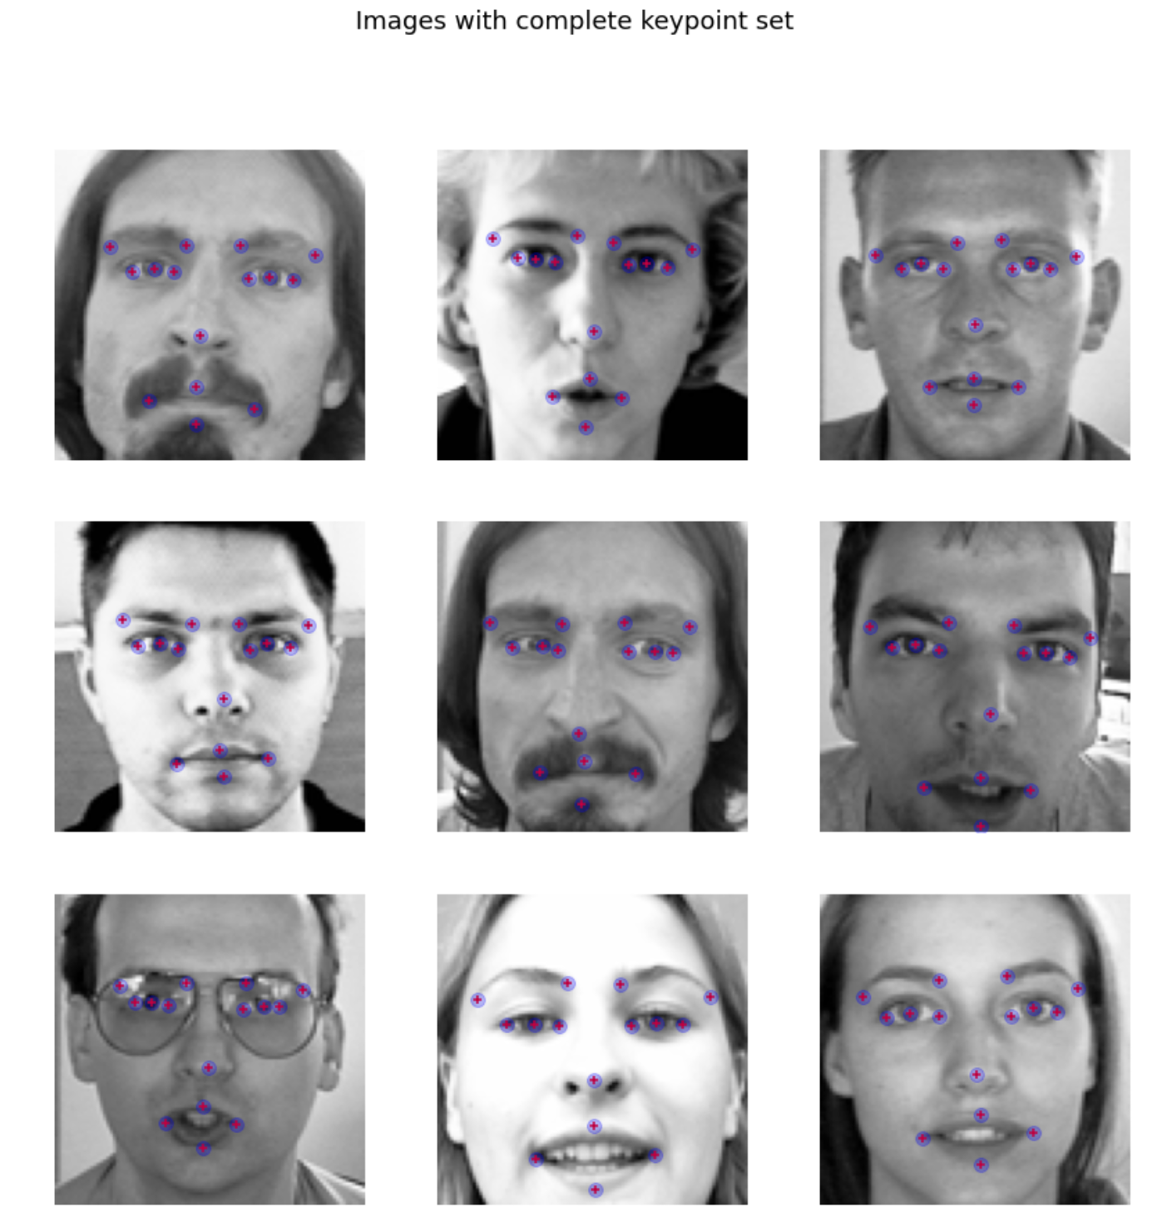
“COMPLETE” SET
Samples with no missing keypoints: 2,140
These samples contain each of the 15 aforementioned keypoints.
Accurate data, despite glasses and hair and different expressions
Generally, every point is clearly visible in the image.

Slide 6
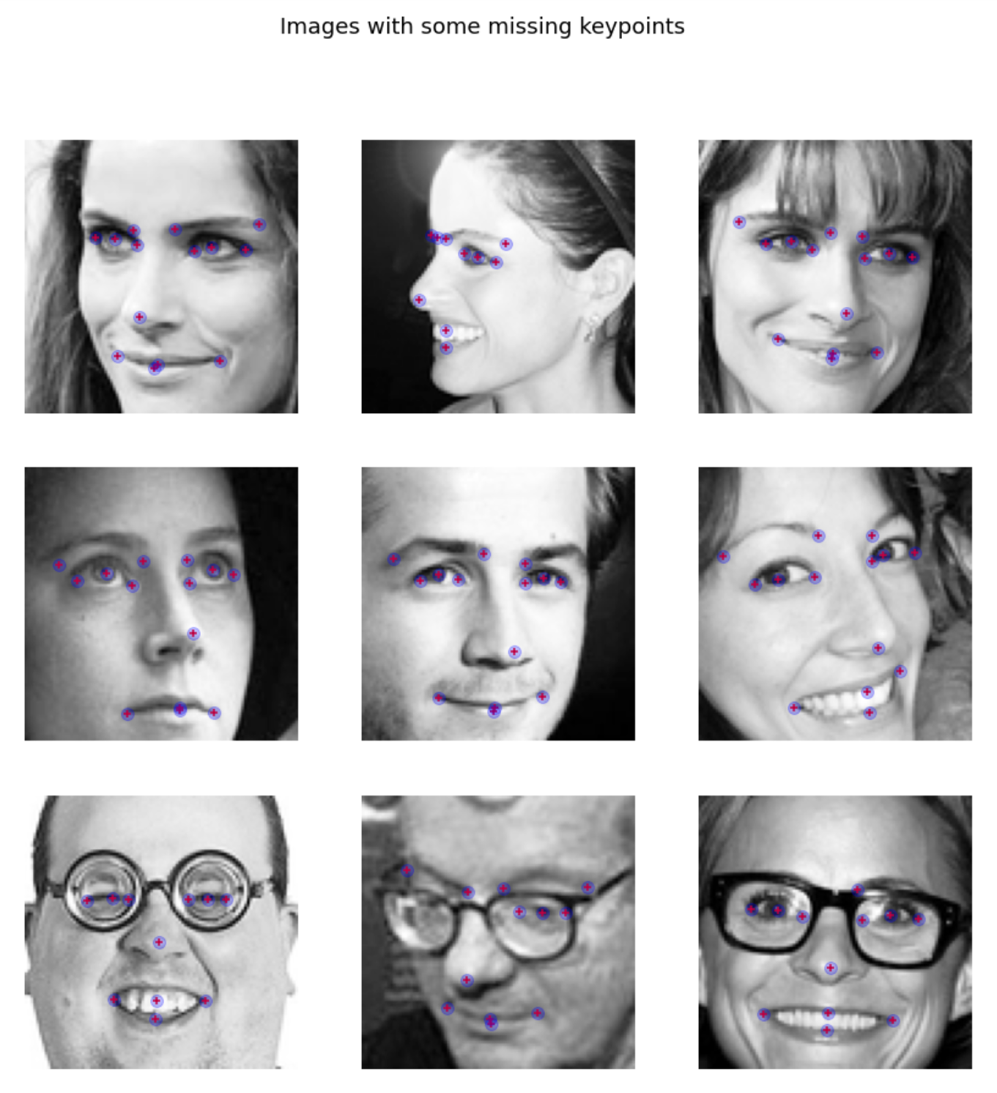
“INCOMPLETE” SET
Many of the items in our training dataset are missing important keypoints.
Some have as few as 4, even though all should be visible.
Samples with missing keypoints: 4,909
We will need to account for. Some images have keypoints blocked by things like hair or glasses.

Slide 7
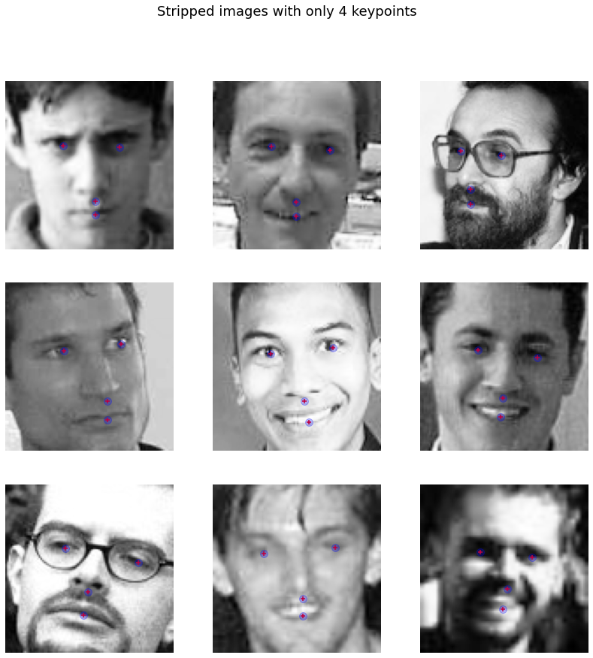

Slide 8
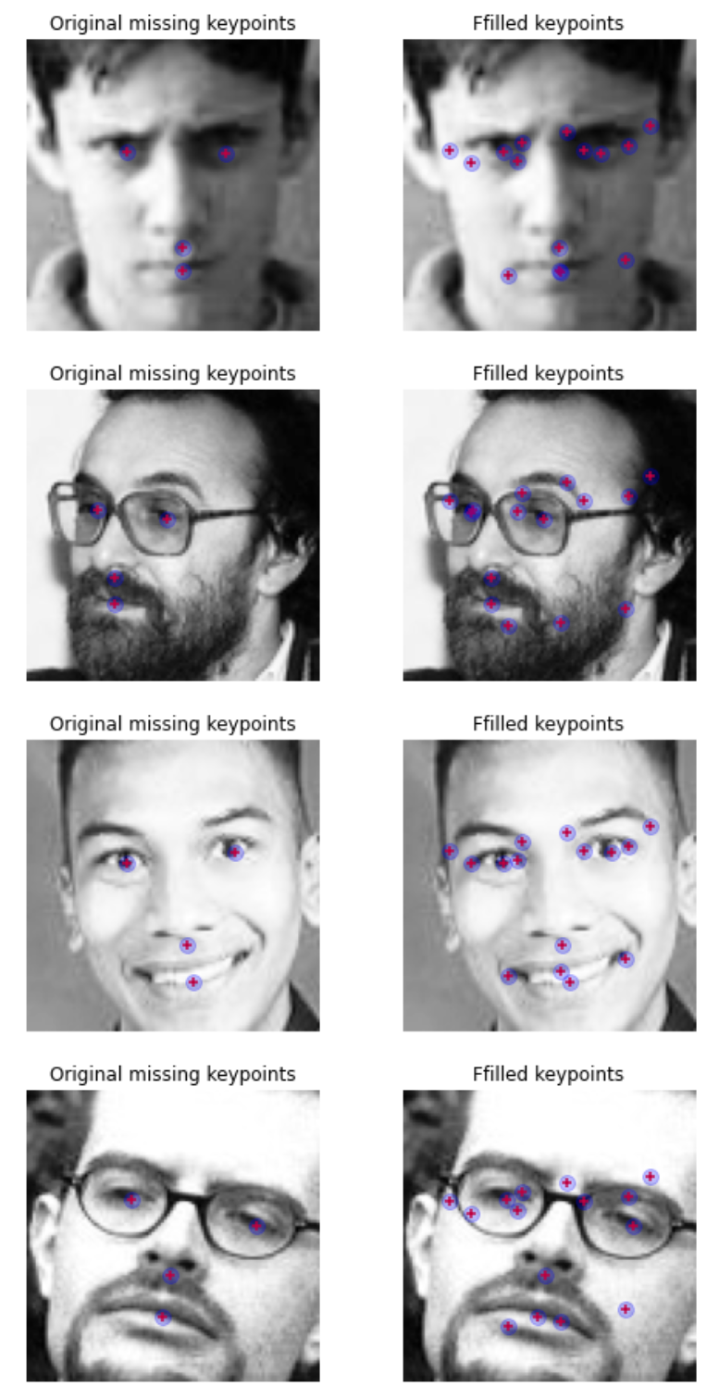
HANDLING OF MISSING KEYPOINTS
Forward Filling - Propagates the last valid observation forward.
Problematic because the images are different and not one size fits all.
Prediction Approach - We'll use our predicted keypoints from our initial models to fill only the missing values in the "incomplete" set.
This solution allows us to use as much of the actual data as we can.

Slide 9
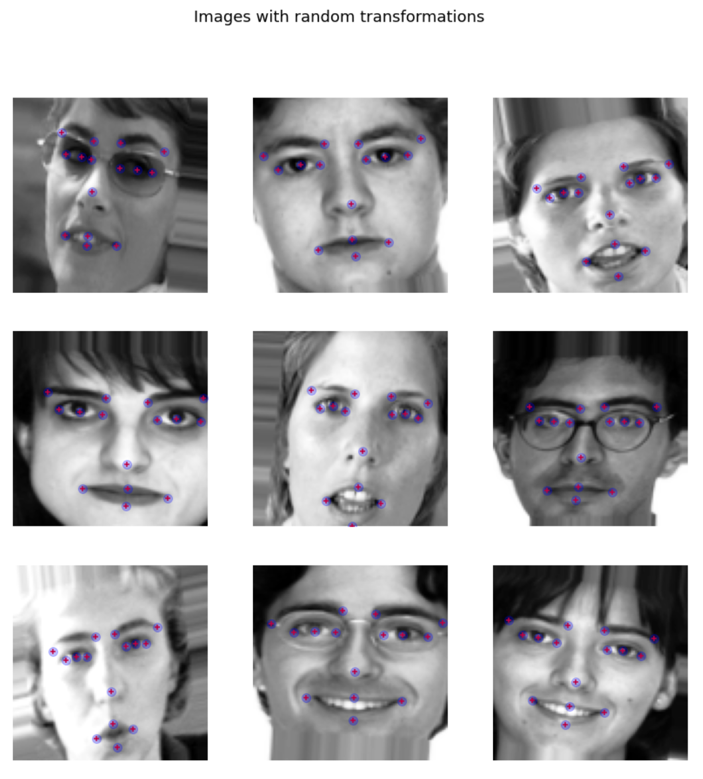
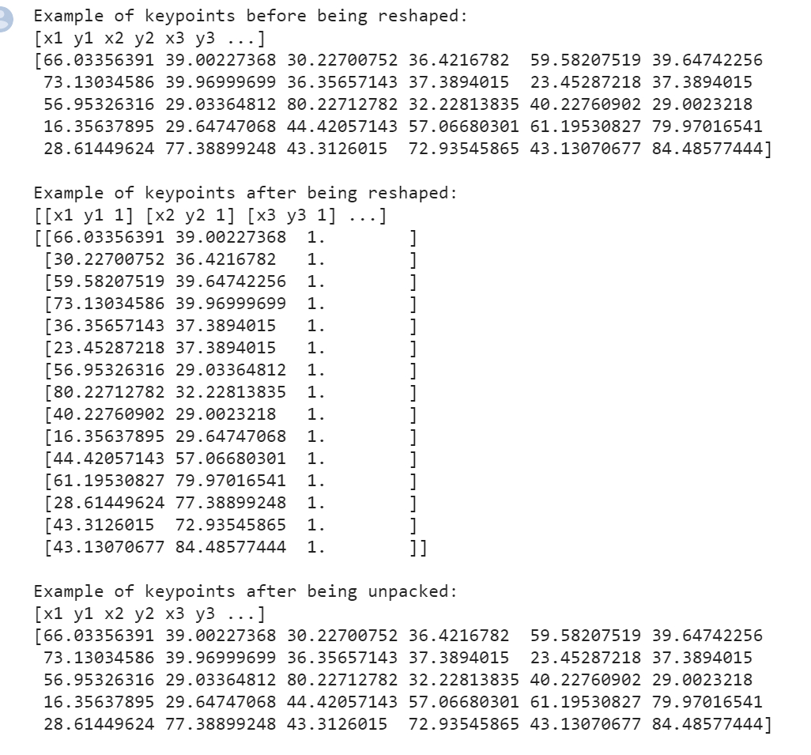
DATA AUGMENTATION
In order to make our model more robust, we will augment our dataset with additional images.
We do this by applying transformations to our images and their keypoints, to move around our data. Such transformations like:
Shifting the images
Shearing the images
Scaling the images
Adjusting brightnesses
The generators will apply transformations from the provided ranges randomly, and the seed will ensure that the keypoints and images are transformed the same way.

Slide 10
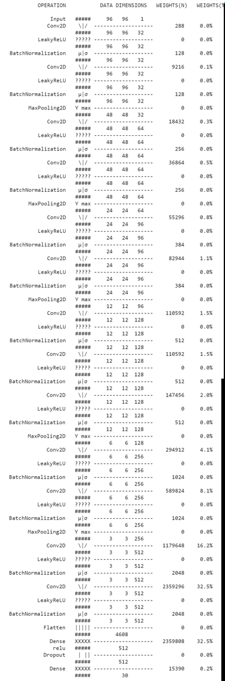
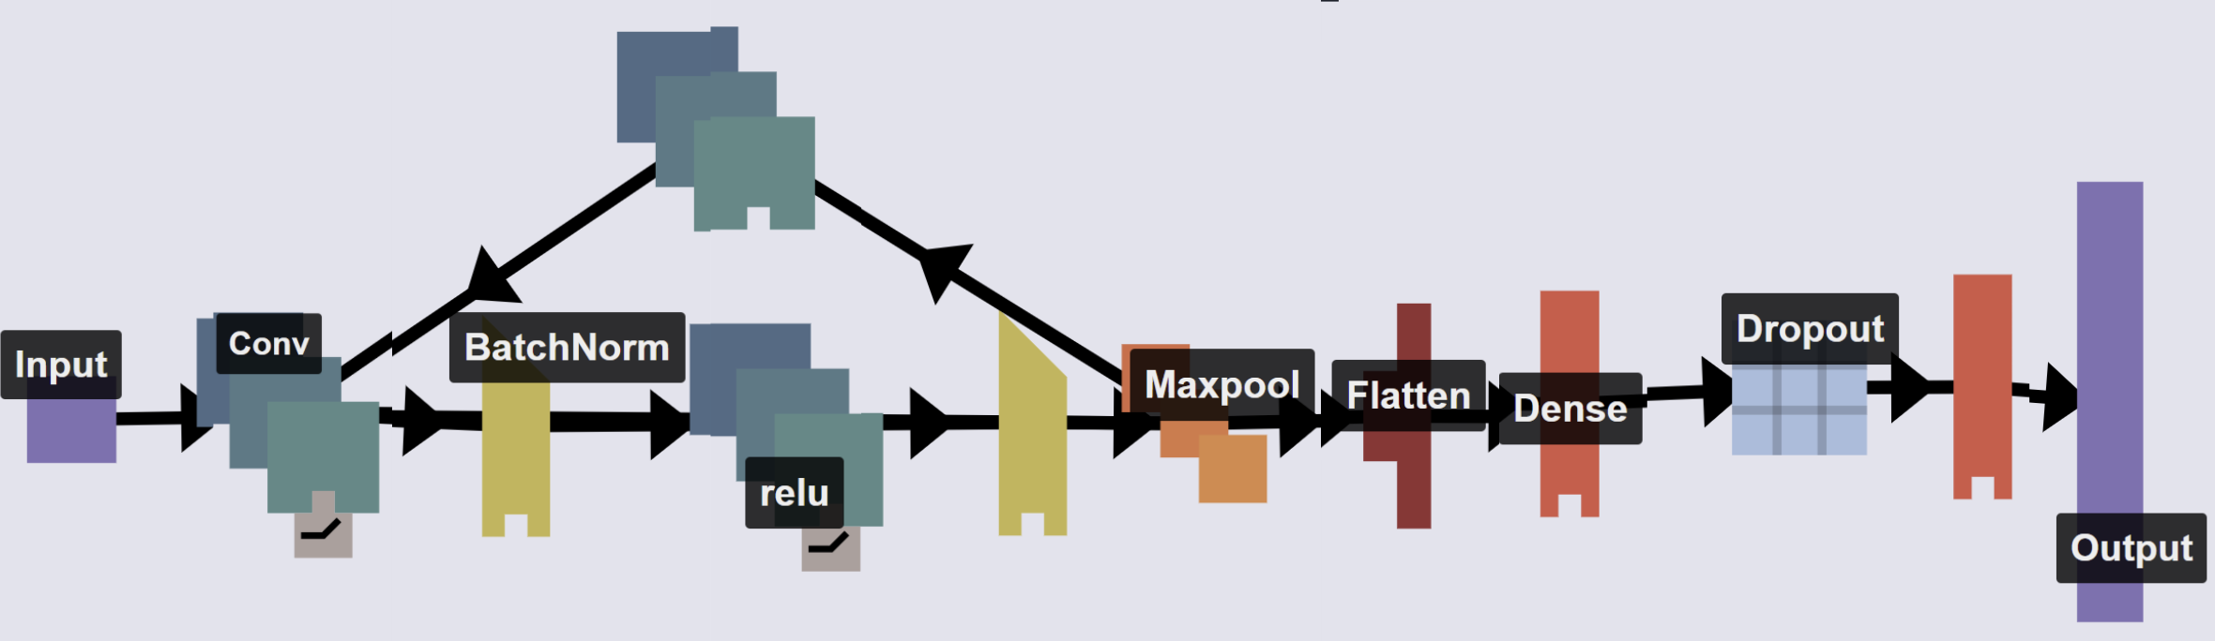
CNN MODEL
Convolutional Neural Network with 32 through 512 filters, and a filter size of 3 x 3, and 1 pixel of padding on each side.
Uses Batch Normalization, Leaky ReLU, Max Pooling, Flatten Layers, Dense Layers, Dropout, ‘Adam’ optimizer
The model ultimately outputs each of the 30 coordinate locations for each facial keypoint.

Slide 11
CNN MODEL TUNING
In developing this convolutional neural network, we tuned our parameters on our training data before selecting a final model structure that we would proceed with.
After a few dozen tuning runs, we ultimately settled on the following model. We wanted one that was very accurate, but one that would not overfit all of our data.
Ultimately, we settled on a model with 2 layers of 32 filters, followed by 2 layers of 64 filters, then 96, 128, 256, and 512, before two dense layers of 512 and 30, after seeing a high accuracy and low MAE value.
The other layers were then optimized and tuned based on these insights, and selected for producing a high accuracies and low MAEs.
SAMPLE OF TUNED RUNS
32-48-64-96-128-256 (256-30):
Acc: 0.7224, Mae: 3.9815
32-64-96-128-192-256 (256-30):
Acc: 0.7119, MAE: 4.0641
32-64-96-128-256-512 (512-30):
Acc: 0.7525, MAE: 3.2551
32-48-64-96-128-256-512 (512-30):
Acc: 0.6007, MAE: 3.2089
32-64-96-128-256-512-1024 (1024-30):
Acc: 0.6056, MAE: 2.8476

Slide 12
DIFFERENT TRAINING SETS
Comparing performance of this CNN design using 3 different sets of data to train.
"Complete" data set with only images that have no missing keypoints
"Augmented" data set consisting of the complete dataset and 4000 additional random transformations
“Predicted Keypoints” data set, where the better performing of the above 2 models will be used to predict the missing keypoints on the images that were missing values.

Slide 13
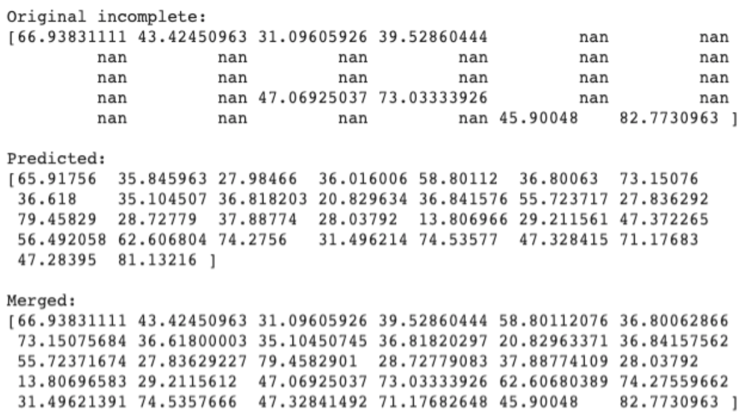
PREDICTED KEYPOINT MODEL
After comparing the models, we were happy with the performance of the Augmented model. So we decided to loop back to our original topic of missing/stripped keypoints.
Using the predicted keypoints from the augmented model, we filled in missing values

Slide 14
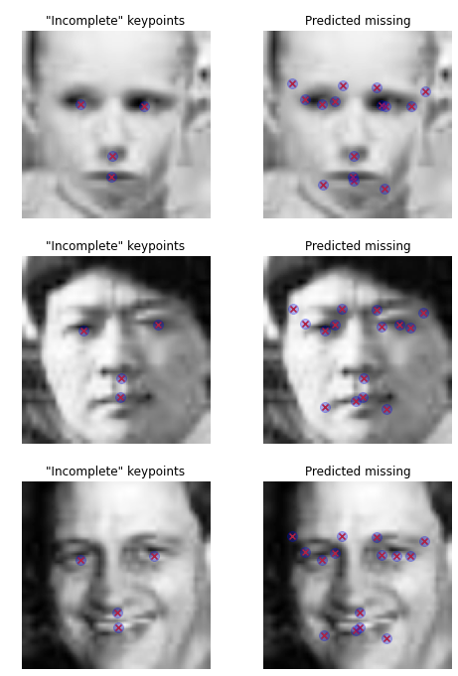
PREDICTED KEYPOINT MODEL
The predicted keypoint model did a decent job in filling in the missing points. Certainly better than forward-filling.
One observation we had, which will become a theme, was that in this model the predictions were all similar in pattern (though not identical). We found that each of our models exhibited a similar rigidity.

Slide 15
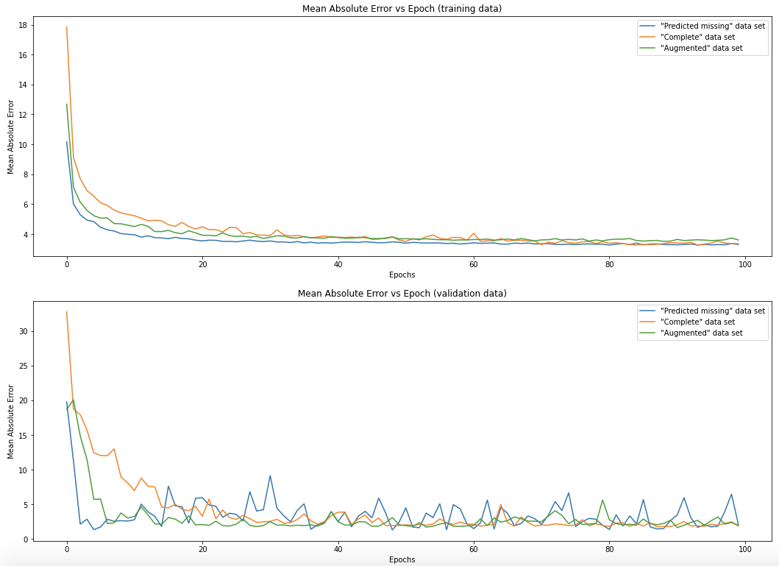

Slide 16
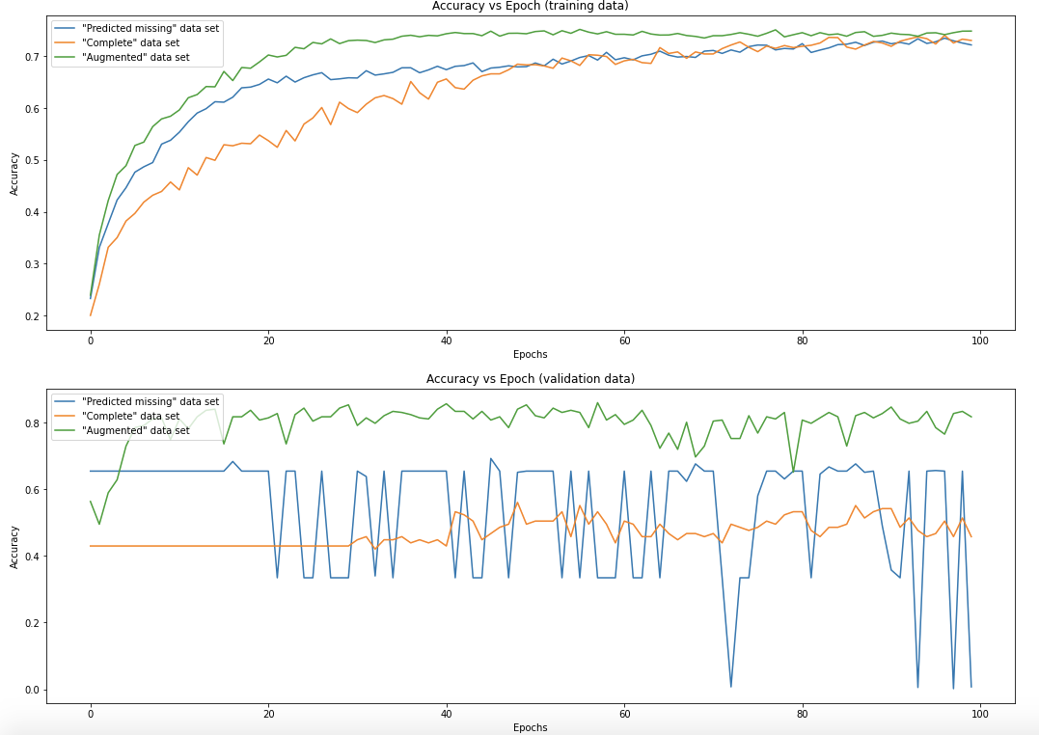

Slide 17
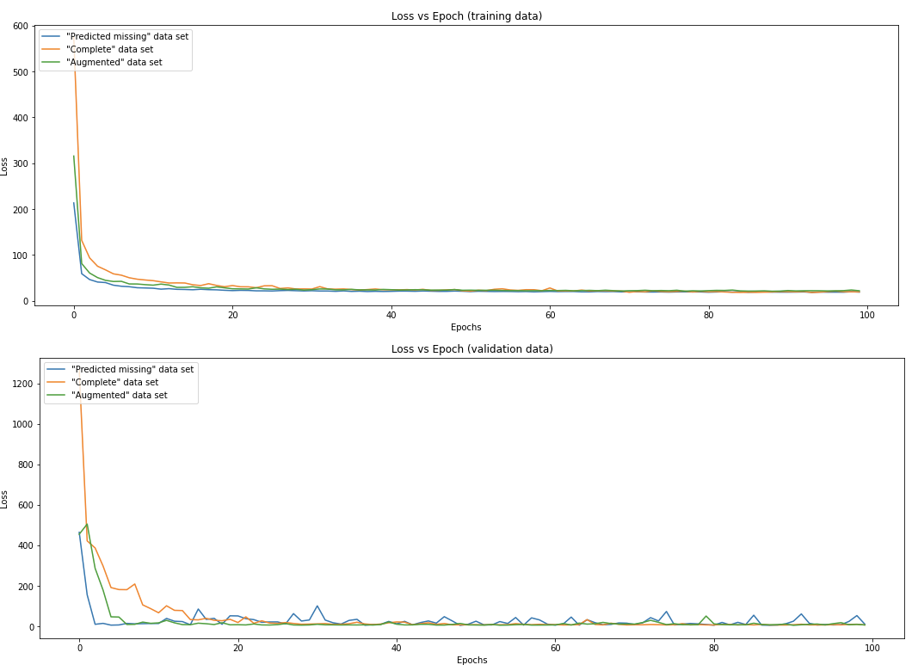

Slide 18
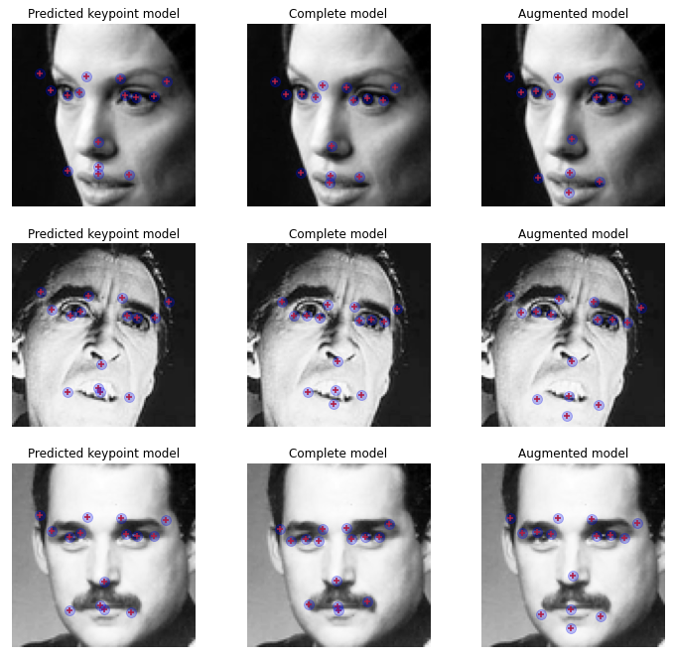

Slide 19
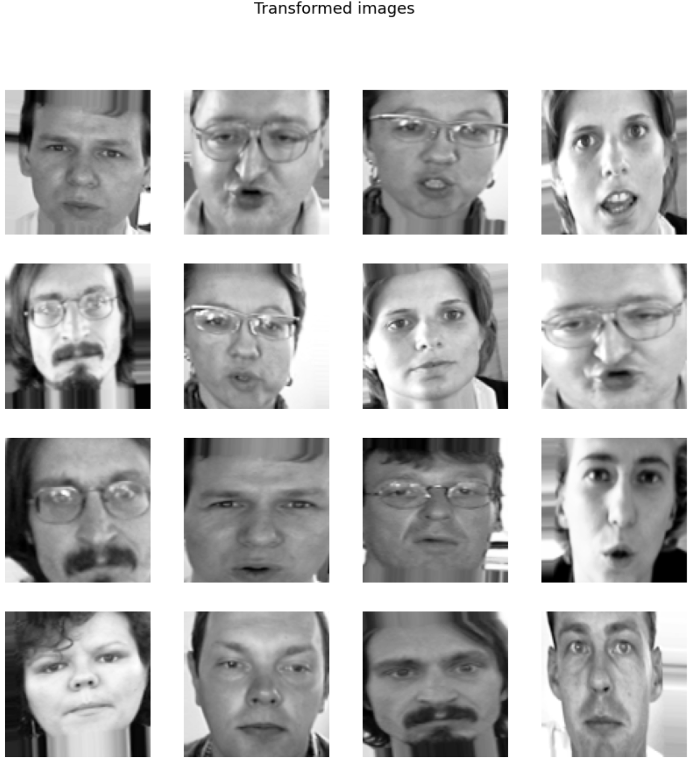
FINAL MODEL
Noticing how inflexible our models were, we hypothesized that this might be due to many of the samples being oriented very similarly.
To address this, our final model we built was trained exclusively on transformed data, by:
Transforming each image in the "Complete" data set
Training intermediate model on that
Predicting the missing keypoints from the "Incomplete" data set
Transforming each of the predicted keypoint images
Training our final model on the combined "complete" and "predicted incomplete" data sets

Slide 20
FINAL MODEL
Final model training data set:
Transformed images with all existing keypoints provided
Transformed images with some keypoints provided and missing keypoints predicted

Slide 21
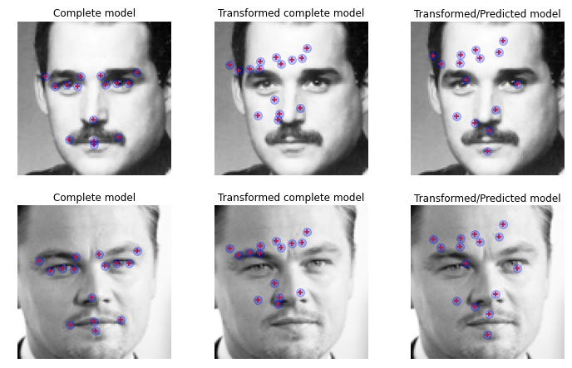

Slide 22
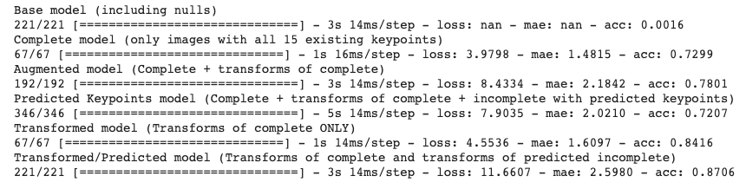
COMPARISON OF MODELS
Ultimately, all of our models performed very well.
Each model finished with an MAE of less than 3.0 and an accuracy of above 0.72.
These are all good predictors of facial keypoints, although our “complete model” appears to be the best, followed by the complete transformed model.

Slide 23
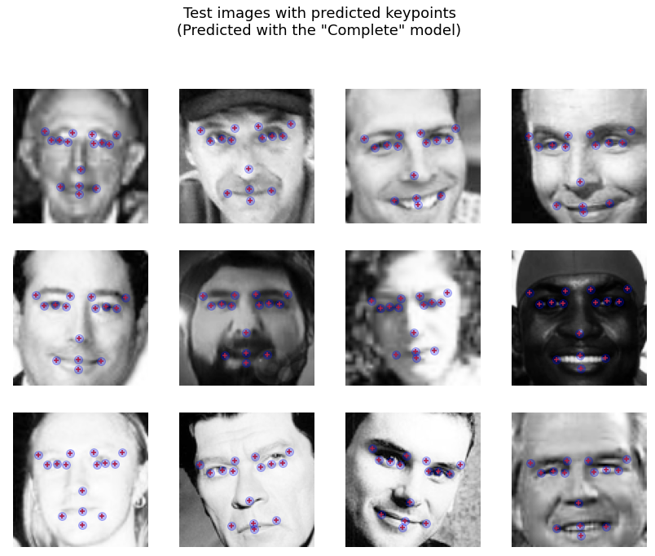
RESULTS
These are some of the predictions of facial keypoints from our model.
They show that model did a good job of understanding and dealing with facial features and differences between images.

Slide 24
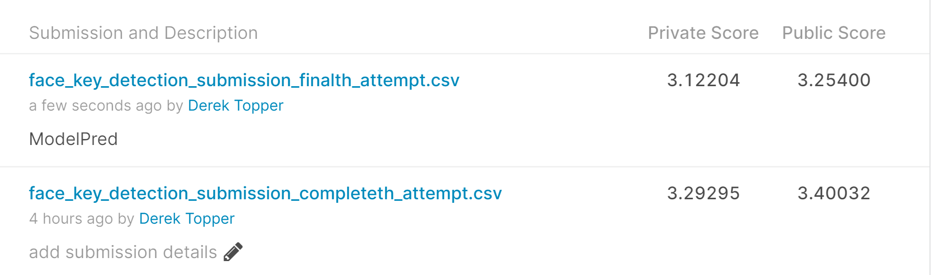
FINAL MODEL RESULTS
Loss - 3.97, MAE - 1.48, Accuracy of 0.73,
Kaggle Score (65th, Private Score of 3.12)

Slide 25
CONCLUSION
Ultimately, we feel that this project was successful, as we predicted the 15 facial keypoints with a relatively high degree of accuracy.
In the future, we would want to expand upon the work that we did to get better predictions from our augmentation models and improve our models through the transformed data.
We feel that we built a few strong models that produced accurate results and explored many new machine learning techniques.

